Slide 1
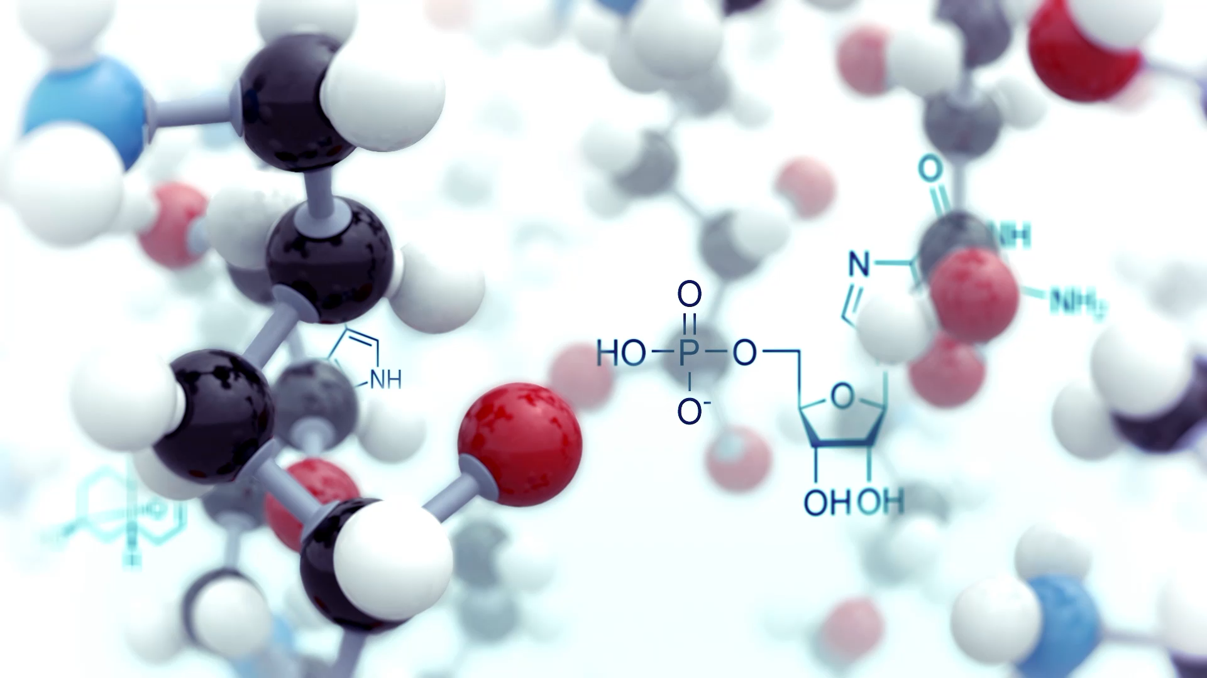
Genes, fathering, and internalising symptoms in children
Research question: How do fathers’ and children’s internalising-associated genetics influence parenting and child internalising phenotypes?
Modelling gene environment correlations, genetic confounding and genetic nurture.
Based on Wertz et al., 2020
Notes:
Didn’t test the effect of fathers

Slide 2
Background
Genes influence child depression
Parenting influences child depression
Children’s genes influence parenting (evocative gene-environment correlation)
Parent’s genes influence parenting (active gene-environment correlation)
BUT
Gene-environment confounding can occur between parenting and child depression:
if genes affecting child depression also affect parenting
if parent depression-associated genetics shape parenting and are also passed onto the children which also affects depression
if child depression-associated genetics influence parenting and child depression
I.e., parenting may be a marker of parent or child depression-associated genetics, without any independent environmental effect on child depression

Slide 3
Variables
Genetics
Father PRS internalising
Child PRS internalising
Parenting
Parent-child conflict (Kane & Garber, 2004)
Positive / negative parenting (Wilson & Durbin, 2010)
Household chaos; cognitively stimulating parenting?
Child internalising - DAWBA
Controls
Child sex (Pingault et al., 2021; Wertz et al., 2020)
Child / father age, ethnicity (Wilson & Durbin, 2010)
Mother PRS internalising

Slide 4
Descriptives
1. Assortative mating – correlation between mother and father PRS and mother and father parenting

Slide 5
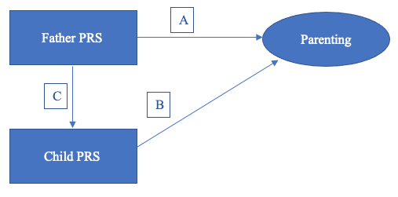
Model 1. Gene- environment correlation
1. Gene-environment correlation?
Direct effect of path A and path B
2. Active gxe correlation?
Path A controlling for child PRS
3. Evocative gxe correlation?
Path B controlling for father PRS

Slide 6
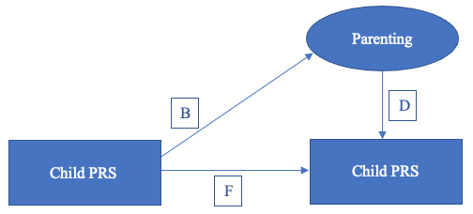
Model 2. Genetic confounding
Genetic confounding if: father PRS affects parenting (A) and the same genes are passed onto children (C) which influence child depression (F) OR if child PRS evoke parenting (B) and influence depression (F)
Path D – does the association reduce after controlling for child PRS?

Slide 7
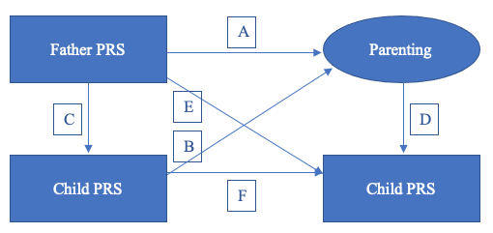
Model 3. Genetic nurture
1. Do father genetics associate over and above child genetics?
Path E: any remaining association after controlling for child PRS
2. Do parental genetics affect child depression over and above genetic transmission via creating environments that influence child depression?
Environmentally mediated effect: path AxD controlling for child PRS, with each parenting mediator entered separately and then all in the same model

Slide 8
References
Kane, P., & Garber, J. (2004). The relations among depression in fathers, children's psychopathology, and father-child conflict: a meta-analysis. Clin Psychol Rev, 24(3), 339-360. https://doi.org/10.1016/j.cpr.2004.03.004
Kong, A., Thorleifsson, G., Frigge Michael, L., Vilhjalmsson Bjarni, J., Young Alexander, I., Thorgeirsson Thorgeir, E., . . . Stefansson, K. (2018). The nature of nurture: Effects of parental genotypes. Science, 359(6374), 424-428. https://doi.org/10.1126/science.aan6877
Pingault, J.-B., Barkhuizen, W., Wang, B., Hannigan, L. J., Eilertsen, E. M., Andreassen, O. A., . . . Havdahl, A. (2021). Identifying intergenerational risk factors for ADHD symptoms using polygenic scores in the Norwegian Mother, Father and Child Cohort. preprint. https://doi.org/10.1101/2021.02.16.21251737
Wertz, J., Moffitt, T. E., Agnew-Blais, J., Arseneault, L., Belsky, D. W., Corcoran, D. L., . . . Caspi, A. (2020). Using DNA From Mothers and Children to Study Parental Investment in Children's Educational Attainment. Child Dev, 91(5), 1745-1761. https://doi.org/10.1111/cdev.13329
Wilson, S., & Durbin, C. E. (2010). Effects of paternal depression on fathers' parenting behaviors: a meta-analytic review. Clin Psychol Rev, 30(2), 167-180. https://doi.org/10.1016/j.cpr.2009.10.007

